Slide 1
Analytical Plan for IHG
Team:
Lodging Leaders
February 9, 2023

Slide 2

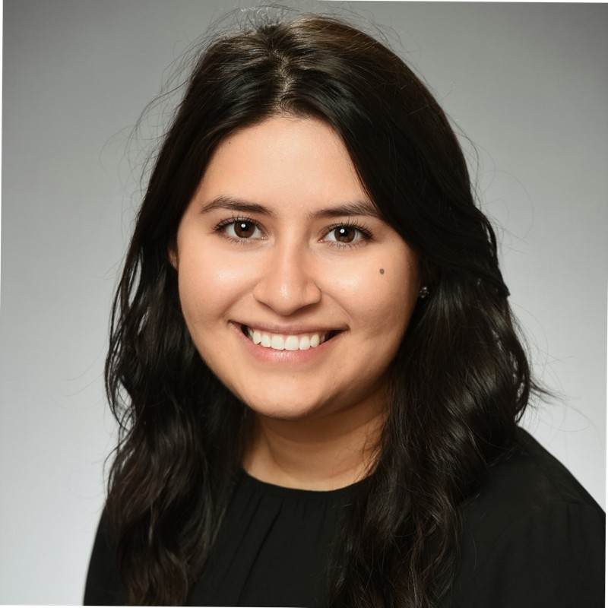


Team Introduction: Lodging Leaders
David Askew
Maria Casas
MS in Applied Statistics and Analytics
Graduating May 2023
McKaleb Harlemon
MS in Applied Statistics and Analytics
Nathaniel Jones
MSIS
Cooking, painting and home improvement projects
MS in Applied Statistics and Analytics
Graduating December 2023
Puzzles, Movies, and Data Science
Graduating June 2023
Hiking, Boating, and Traveling.
Graduating May 2024
Sports Psychology

Slide 3
Problem Overview

Slide 4
Problem Overview
General Problem
Can we accurately predict whether a rewards member will click an email?
Why It Matters
IHG can be better informed to select optimal audiences for specific campaigns to increase revenue
Our analysis can generate a better understanding of customer base:
Type of member profile, stay history and promotional email interactions make a rewards member more likely to click on an email
Understand stay patterns prior to each email being sent/received
Notes:
C

Slide 5
Project Timeline
Analytical Plan
2023-02-09
Initial Analysis Results
2023-03-16
Deliver Project to IHG
2023-04-28
Exploration
Data Preprocessing & Modeling
Evaluate, Refine, Interpret, and
Packaging Insights
Present and Report
Notes:
Before continuing, we have our expected timeline related to the project.
It starts before today where we have worked on exploring the data and understanding the problem.
In the near future,
we will complete our preprocessing of the data,
Engineer features we think may be important,
And select the best features to predict click. [CLICK]
We will present our initial results in March. [CLICK]
After which, we will continue to evaluate and refine our models to find the one that best explains click.
We will then interpret this model and package the insights for delivery [CLICK] on April 28th.
[PAUSE] [CLICK] [CLICK]

Slide 6
Problem Details

Slide 7
Key Assumptions
If an email marketing link was clicked (CLICK = 1),
Then a member clicked on either an
Offer page or Non-offer page
Unsubscribed
If an email marketing link was not clicked (CLICK = 0),
Then the email may have been opened, but no way to confirm
Cancelled stays are not included in the stay history dataset
All confirmation dates have a check-in and check-out date
Notes:
D

Slide 8

Problem Diagram
Email History
Click Indicator
Stay History
Clicked Offer Page
Unsubscribe Link
Clicked Non-Offer Page
Purchase hotel stay
Defers Product
Member Details
Future research questions connecting to this project
Notes:
D

Slide 9
Goals
We aim to answer the following questions with our analysis:
Primary Goals
What is the probability that any one member clicks on the email marketing link?
Secondary Goals
What type of member profile, stay history and promotional email interactions make a rewards member more likely to click on an email?
Can these predictions be quantified by traveler type (business vs. leisure), hotel chain, or by stay type (smaller parties vs. families)?
How much revenue we can expect to make given specific attributes of our hypothetical hotel?
Notes:
D

Slide 10
Narrowing the Scope
Email History:
192 Million (1.2M unique members)
Jan. 1st, 2020 – Jan. 31st, 2022 (Day Increments)
Target Variable (CLICK)
Member Details
Stay History
All members were sent at least one promotional email in the time frame above that they either did or did not click on.
Will use all stay history to understand each members’ travel history prior to each email being sent or received
Email History
Emails are sent each day to a subgroup of members.
Notes:
D

Slide 11
Data Discovery

Slide 12
Data Sources
 | Member Details | Email History | Stay History
Number of Observations | 1,233,429 | 192,134,206 | 4,724,918
Number of Distinct Members | 1,233,429 | 1,233,429 | 729,016
Total Variables | 11 | 8 | 17
Member Details
While every member received at least one marketing email, only 6 of every 10 members have a stay history
1:1
Email History
59%
41%
Stay History
Notes:
M

Slide 13
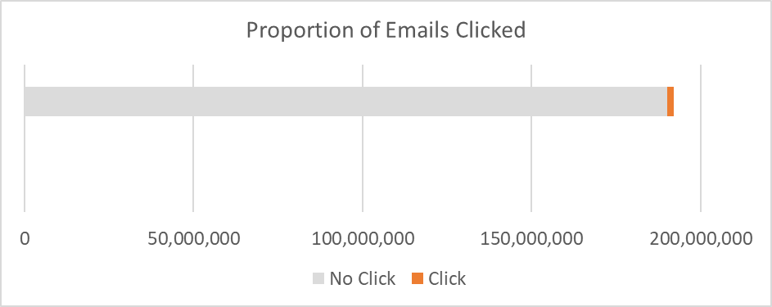
Target Variable
CLICK
0 = Member did not click on any links
1 = Member clicked an offer or non-offer link, or unsubscribed from emails
Imbalanced variable as only 1% of email links were clicked
We will research best methods for working with this imbalance
Notes:
M

Slide 14
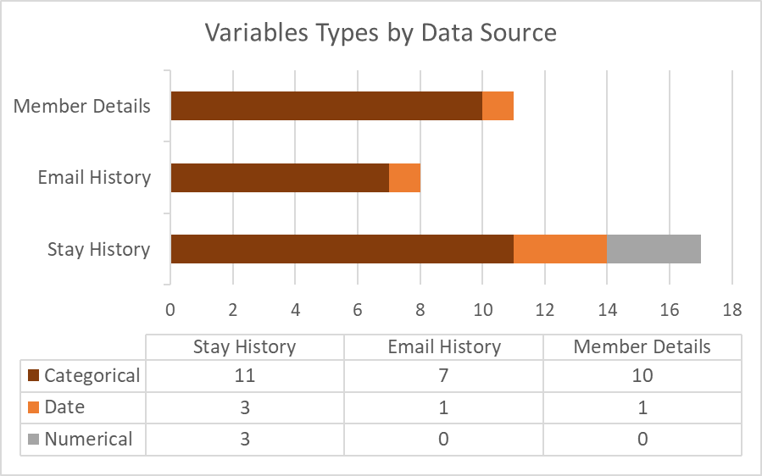
Provided Variables
Mostly categorical variables
This make-up has implications on the modeling methods we will use
Binning or aggregation for variables with high number of unique values
Dates are key for derived variables
All relative to email send date
“Weeks since” or “Count in last 0-2 months”
Heavily skewed numeric variables
Potential to bin these values

Slide 15
Preprocessing
Stay history data source is room based
Opportunity to aggregate to stay based
Depending on modeling approach, data cleaning and imputation will be needed
Very small presence of null values
Understanding distribution of derived variables will help set plan for binning, if necessary
Conduct feature selection – set aside irrelevant or redundant variables

Slide 16
Feature Engineering
Member Variables
Email Variables
Stay Variables
Enroll Channel
Total Clicks
Days Since Last Holiday
Total Unique Stays
Weeks Since Last Stay
Most Recent Member Tier
Proportion of Clicks by Campaign Type
Days Until Next Holiday
Average Nights per Stay
Proportion of Stays by Purpose
Most Recent Member Lifecycle
Click Rate by Member
Indicator for Recent Change in Membership Tier
Total Revenue
Weeks Since Last Booking
Age Group
Membership Tenure on Email Send Date
Seasonal Indicator
Average Revenue per Stay
Average Days Between Conf. and Check-In
Income Group
Days Since Last Click
Weekday Indicator
Total Number of Nights Stayed
Proportion of Stays by Hotel Chain Category
Gender
Days Since Last Email
Total Emails Received
Average Guest Quantity per Stay
Proportion of Stays Paid by Points/Rewards
Weeks in Current Tier
Weeks in Current Lifecycle
Weeks Since Last Points/Rewards Stay
Proportion of Stays with more than 1 Guest

Slide 17
Expected Approach

Slide 18
Expected Approach | Issues to Overcome
Imbalance Member Classes
99% Do Not Click
1% Do Click
Categorical Explosion
Campaign Details
Member's Demographics
Emails sent to members overtime
Notes:
Combination of random and stratified oversampling for target variable
https://towardsdatascience.com/class-imbalance-in-machine-learning-problems-a-practical-guide-4fb81eee0041

Slide 19
Expected Approach | Emails Overtime
Aggregated timeframes will be relative to the email send date
2022
2020
2021
Start Point
Jan. 1st, 2020
Jan. 31st, 2022
Member's Email History with IHG
Long History
Short History
1/31/2022
Notes:
The data is given ranges over 2 years and 1 month [CLICK] starting Jan. 1st, 2020 and ending Jan. 31st, 2022. [CLICK]
For any day in that range, IHG may send an email to a subgroup of members [CLICK] with a email history [CLICK] relative to that day.
Other members may not receive an email that day, but they may have received a email on a previous day.[CLICK]
We want to use an increment of time like a day, week, or 2 week period to build our model. [CLICK]
https://towardsdatascience.com/class-imbalance-in-machine-learning-problems-a-practical-guide-4fb81eee0041
https://www.youtube.com/watch?v=kfBfzQh84Ks

Slide 20
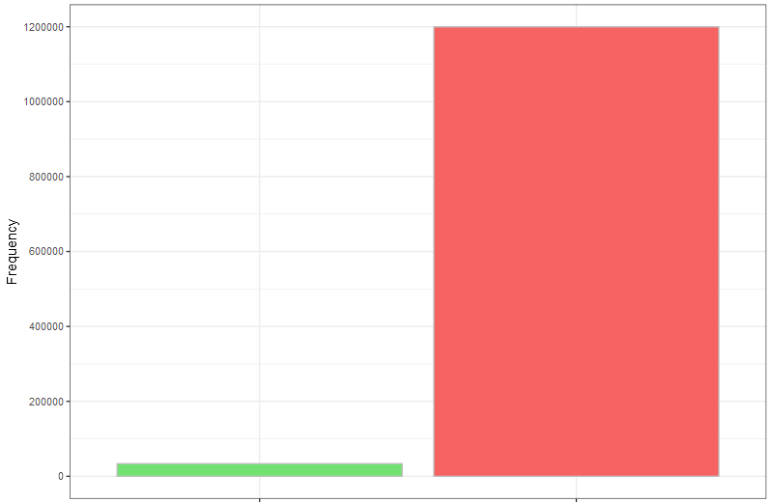
Expected Approach | Data Partition
Frequency of Member Click for the Most Recent Email Sent
Model Performance
2.7 %
97.3 %
As of 1/31/2022 day
1,095,836 rows
Stratified K-Folds Cross Validation
Splits data into K-groups
Oversamples each group
All observations are used
Test =
Training =
1
2
3
...
k
P₁
1
2
3
...
k
P₂
1
2
3
...
k
P₃
...
1
2
3
...
k
P_{k}
P₁ + …. + P_{k}
= Overall Model Performance​
k
Click
No Click
Member Click
Notes:
Suppose we use the most recent day, jan 31st. 2022. [CLICK]
Filtering the data would leave a little over a million rows of data. [CLICK]
Where 3 % of members clicked an email while 97 % did not.
Compared to the overall 1 % click and 99 % not click. [CLICK]
Next, we will split the 1.1million rows into some number of groups and assign one group as the test set.
The others will be used to train a model and get a performance value. [CLICK]
We'll then choose another group and repeat the process until each group is used as the test set. [CLICK]
An overall model performance value can be computed from this process that can aid in producing an accurate model. [CLICK]
This helps us achieve the problem goals because stratified k-folds oversamples the rare class for each of the groups [CLICK]
In addition, all of the observations will be used to test our model. [CLICK]
https://towardsdatascience.com/class-imbalance-in-machine-learning-problems-a-practical-guide-4fb81eee0041

Slide 21
Expected Approach | Problem Statement
Can we accurately predict whether a member will click an email?
Notes:
Before talking about our modeling approach, I want to bring the problem statement back in mind.
The key words in this statement are accurately predict, member, and click.
To me this translates into build an accurate model that we can interpret, build in 5 weeks, and use to provide a better service.
So when choosing a model to do this, thinking about the attributes the data exhibits is important.
Things such as the class imbalance or the high number of categories can hinder a models performance. [CLICK]
https://towardsdatascience.com/class-imbalance-in-machine-learning-problems-a-practical-guide-4fb81eee0041

Slide 22
Expected Approach | Modeling Approach
Decision Tree Model
Requires little data preparation
Not effected by missing or extreme values
Handles Class Imbalance
Can be used for feature selection
2. Naive Bayes Model
Fast, Real-time predictions
Handles the number of categorical data
Can outperform a decision tree model
Notes:
The models we are focusing on building will be a decision tree model [CLICK] and a naïve bayes model. [CLICK]
Building these models will allow us to compare the different algorithmic approaches on the data. [CLICK]
In addition to that the decision tree model requires very littler data preparation and [CLICK] is not effected by missing or extreme values.
This model also handles our [CLICK] class imbalance issue, but could be very slow to train depending on the number of rows and columns used. [CLICK]
On the other hand, the naïve bayes model is fast and can provide real-time predictions. [CLICK]
This model also works really well with a high number of categorical columns, like the data we have. [CLICK]
It can also outperform a decision tree model and be used to generatively produce likelihoods. [CLICK]
Mention performance metrics that we will use

Slide 23
Expected Approach - Deliverables
Interactive Dashboard
(Mockup below)
Notes:
https://www.justintodata.com/python-interactive-dashboard-with-plotly-dash-tutorial/

Slide 24
THANK YOU

